Slide 1
School of Financial Discipline
Session 2
Love of Money-root of all evil

Slide 2
What are the evils that come along with the Love of Money
Love of money & the Evils it bring in

Slide 3
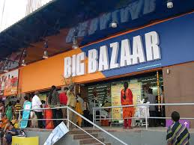
1. Is 5:8-9 Houses will become desolate & without occupants
Isa 5:8 "How terrible it will be for you who join house to house, who add field to field, until there is no more room, and you have settled yourselves alone in the middle of the land!"
Isa 5:9 ......."Surely many houses will become desolate, great and beautiful houses, without occupants.
(Cletus Vincent)

Slide 4
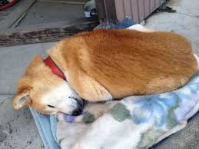
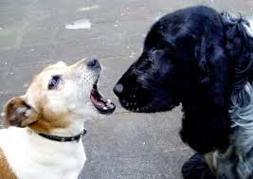
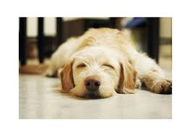

2. Isa 56:11 – Makes shepherds dumb dogs that cannot bark
Isa 56:10,11 His watchmen are blind; they are all without knowledge. They are all dumb dogs—they cannot bark. They keep on dreaming and lying around, and they're lovers of sleep!
Yea, they are greedy dogs which can never have enough; and they are shepherds who cannot understand. They all look to their own way, every one for his gain, to his own end.

Slide 5
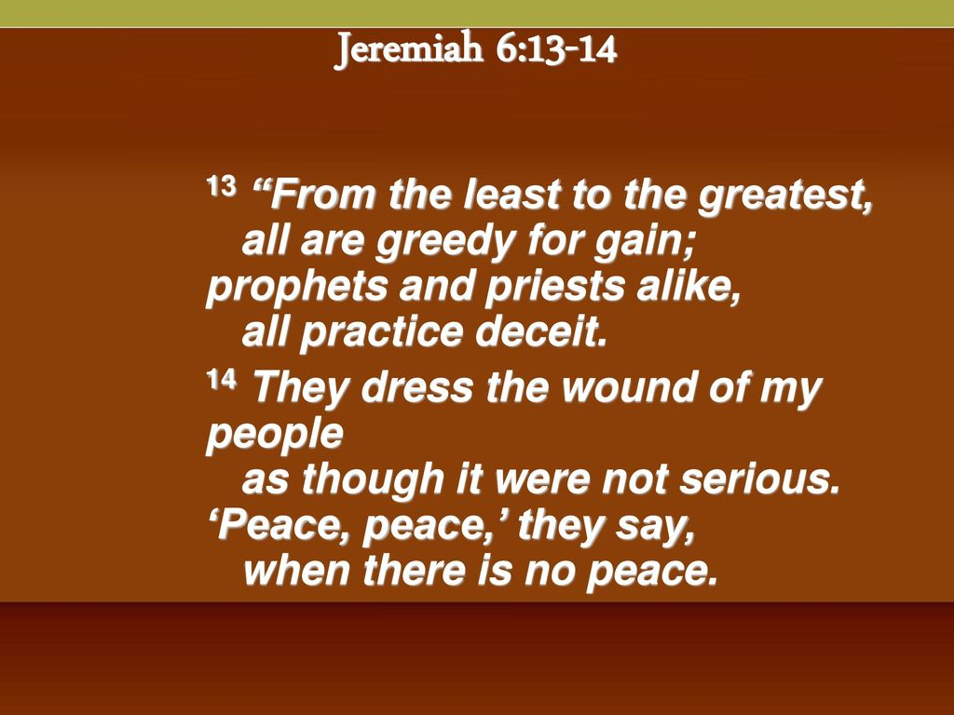
3. Jer 6:13, 8:10 – Make prophet & priest treat the wounds superficially
Jer 6:13-14 Indeed, from the least important to the most important, they're all greedy for dishonest gain. From prophet to priest, they all act deceitfully. They treated my people's wound superficially, telling them, 'Peace, peace,' but there is no peace.

Slide 6
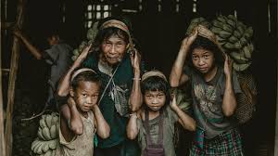
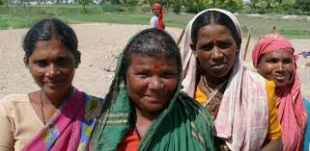
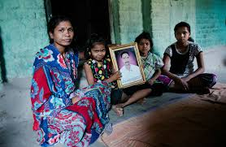
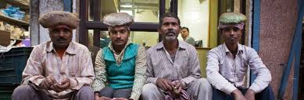
4. Jer 22:17-19 cause innocent bloodshed, oppression & extortion
Jer 22:17-19 But your eyes and heart are on nothing but your dishonest gain, shedding the blood of innocent people, and practicing oppression and extortion. …………
"He will receive a donkey's burial, dragged out
and thrown outside
the gates of
Jerusalem."

Slide 7
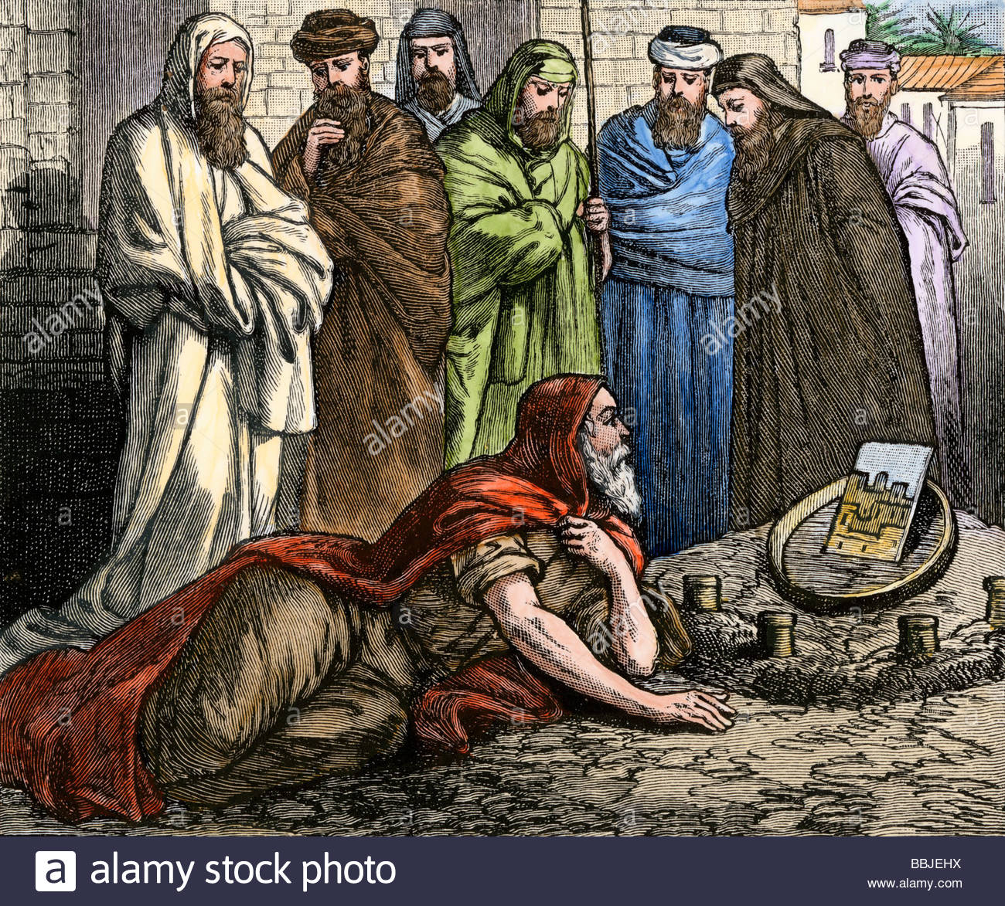
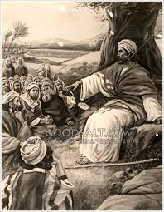
5. Eze 33:31 Make one follow own self interest & desires disobeying prophecies
Eze 33:31 Then they come to you as a group, sit down right in front of you as if they were my people, hear your words—and then they don't do what you say—because they're seeking only their own desires, they pursue ill-gotten profits, and they keep following their own self-interests.

Slide 8
6. Mic 2:2-4 Complete ruin & Heritage given to others!
Mic 2:2 -4 They covet fields and seize them; they covet houses, and grab them, too. They harass the valiant man, along with his household, an individual and his estate." Therefore this is what the LORD says, "I'm crafting evil against this family, from which you can't escape. You won't strut around arrogantly, because the times are evil. When this happens, someone will compose a proverb about you, lamenting sorrowfully, 'We are completely ruined! He has given my people's heritage to others. How he has removed it from me, dividing up our fields!'

Slide 9
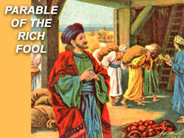

7. Luk 12:15,20 All accumulated wealth goes to others
Luk 12:15 Then he told them, "Be careful to guard yourselves against every kind of greed, because a person's life doesn't consist of the amount of possessions he has."
Luk 12:20 But God told him, 'You fool! This very night your life will be demanded back from you. Now who will get the things you've accumulated?'

Slide 10

8. Eph 5:3,5 Will lose the Kingdom of the Messaiah & of God. 1Co 6:10
Eph 5:3 Do not let …… impurity of any kind, or greed even be mentioned among you, as is proper for saints.
Eph 5:5 For you know very well that ……. No one who is greedy (that is, an idolater), has an inheritance in the kingdom of the Messiah and of God.

Slide 11
9. Col 3:5 – Wrath of God will be upon
Col 3:5 So put to death your worldly impulses: sexual sin, impurity, passion, evil desire, and greed.
Col 3:6 It is because of these things that the wrath of God is coming on those who are disobedient.

Slide 12
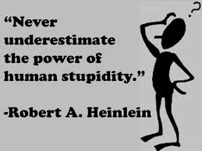
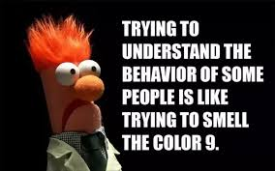
10. 1 Ti 6:9 Trapped by stupid & harmful desires
1Ti 6:9 But people who want to get rich keep toppling into temptation and are trapped by many stupid and harmful desires that plunge them into destruction and ruin.
(Make you barren)

Slide 13
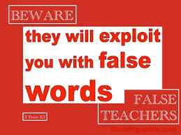
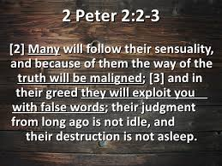
11. 2 Pet 2:3 Exploit others with deceptive words
2 Pet 2:3 In their greed they will exploit you with deceptive words.

Slide 14
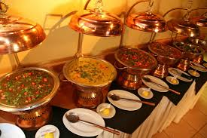

12. 2 Pet 2:13-14 Results in other sins like wild parties,..... adultery, seducing unsteady souls etc.
2Pe 2:13,14 ……. “They take pleasure in wild parties in broad daylight. They are stains and blemishes, revelling in their deceitful pleasures while they eat with you.
With eyes full of adultery, they cannot get enough of sin. They seduce unsteady souls and have had their hearts expertly trained in greed. They are doomed to a curse.

Slide 15
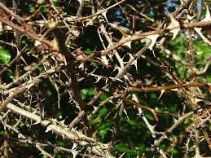
13. Luk 8:14 Fruit will not mature
Luk 8:14 The ones that fell among the thorn bushes are the people who listen, but as they go on their way they are choked by the worries, wealth, and pleasures of life, and their fruit doesn't mature.

Slide 16
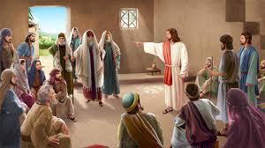
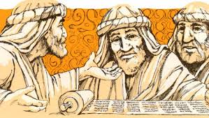
14. Luk 16:14 Ridiculing Jesus (Word) & justifying self in front of people
Luk 16:14-15 Now the Pharisees, who love money, had been listening to all this and began to ridicule Jesus. So he told them, "You try to justify yourselves in front of people, but God knows your hearts, because what is highly valued by people is detestable to God.

Slide 17
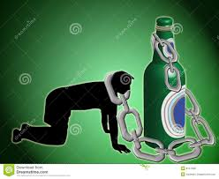
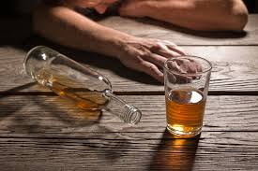
15. Luk 21:34-35 The day of the Lord will come like trap
Luk 21:34 "Constantly be on your guard so that your hearts will not be loaded down with self-indulgence, drunkenness, and the worries of this life, or that day will take you by surprise
Luk 21:35 like a trap, because it will come on everyone who lives on the face of the earth.

Slide 18
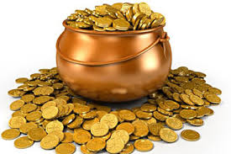

16. Job 31:24-25,28 sin of deceiving God, & deserves judgement
Job 1:24 "If I've put my confidence in gold, if I've told gold, 'You're my security,'
Job 31:25 if I've found joy in great wealth that I own, if I've earned a lot with my own hands,
Job 31:28 this is also a sin that deserves to be judged, since I would have tried to deceive God above."

Slide 19

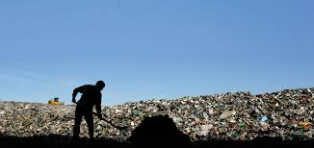
17. Psa 119:36-37 Lead to worthless things
Psa 119:36 Turn my heart to your decrees and away from unjust gain.
Psa 119:37 Turn my eyes away from gazing at worthless things, and revive me by your ways.
Death in Arockiapuram, Kallakudy

Slide 20

18. Pro 23:4-5. Wealth flies to the sky like an eagle
Pro 23:4 Don't exhaust yourself acquiring wealth; be smart enough to stop.
Pro 23:5 When you fix your gaze on it, it's gone, for it sprouts wings for itself and flies to the sky like an eagle.

Slide 21
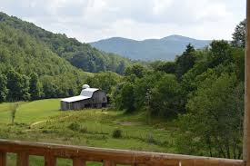
19. Hab 2:9,10 brings shame & forfeits own life
Hab 2:9,10 "Woe to the one who amasses profit upon unjust profit in order to establish his household, so he can establish a secure place on the heights and escape from the power of evil. You have brought shame to yourself by killing many people—you are forfeiting your own life.

Slide 22


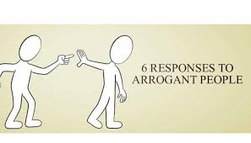
20. Mar 7:22-23 Makes a person unclean
Mar 7:22 -23 …… greed, wickedness, cheating, shameless lust, envy, slander, arrogance, and foolishness. All these things come from inside and make a person unclean."

Slide 23
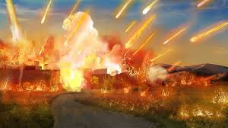
21. 2 Pet 2:3 Immediate destruction
2 Pet 2:3 In their greed they will exploit you with deceptive words. The ancient verdict against them is still in force, and their destruction is not delayed.

Slide 24
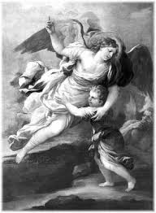
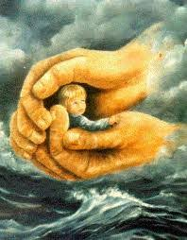
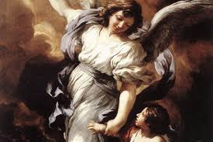
22. Heb 13:5 lose God’s protection
Heb 13:5 Keep your lives free from the love of money, and be content with what you have, for God has said, "I will never leave you or abandon you.“
When one starts putting trust in money, God’s protection will leave.
Eg. God’s protection (Personal Experience)

Slide 25
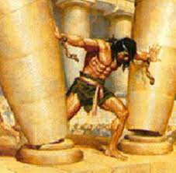
23. Leads to betraying own people Jud 16:18
Jdg 16:18 When Delilah saw that he had told her all his heart, she sent and called for the lords of the Philistines, saying, “Come up this once, for he has told me all his heart.” Then the lords of the Philistines came up to her, and brought the money in their hand.
(God’s warning in requesting land)

Slide 26
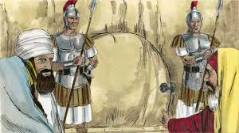
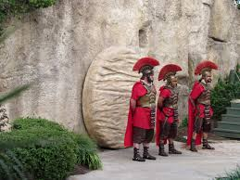
24. Leads to spreading lies & hiding truth
Mat 28:15 So they took the money and did as they were told. This saying was spread abroad among the Jews, and continues until today.
(Cheque received sent back.)

Slide 27
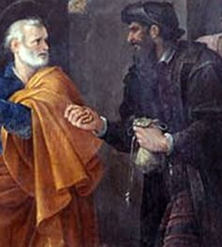
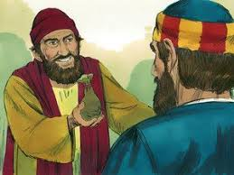
25.Tempted to buy Holy Spirit
Act 8:18 Now when Simon saw that the Holy Spirit was given through the laying on of the apostles’ hands, he offered them money,
Act 8:20 But Peter said to him, “May your silver perish with you, because you thought you could obtain the gift of God with money!

